Slide 1
Artificial Intelligence in Fintech Quiz (1)
Shaif Chowdhury February 2, 2022
1 Question 1
Summarize singular value decomposition (SVD) and its possible applications in Fintech (10 points)
SVD is a matrix factorization technique that would represent a matrix as a product of
Σ Σ
two unitary matrix (U,V*) and a rectangular diagonal matrix ( ), i.e : X = U V ∗ .
SVD has application across different range of problems like least square, pseudo inverse and data types like image, remote sensing, financial data, time series etc.
Here U is formed of orthonormal eigenvectors of XX^{T} , V* is transpose of that i.e : X^{T} X
All matrix have a SVD, which makes it a good option compared to other ways of decom- position.
Application of SVD in Fintech :
SVD can help reduce dimensionality of financial data using decomposition.
SVD can help us measure the spread/concentration of variance in the data.
SVD can be used to do principle Component Analysis, which helps in visualization, analysis and prediction of financial data.
3. SVD [1]is useful in multi-variate time series data, ie : daily stock data.
2 Question 1
APPL, BAC, WMT, AEO, EU-Option, Option-OTM Visualize data with any methods you like

Slide 2
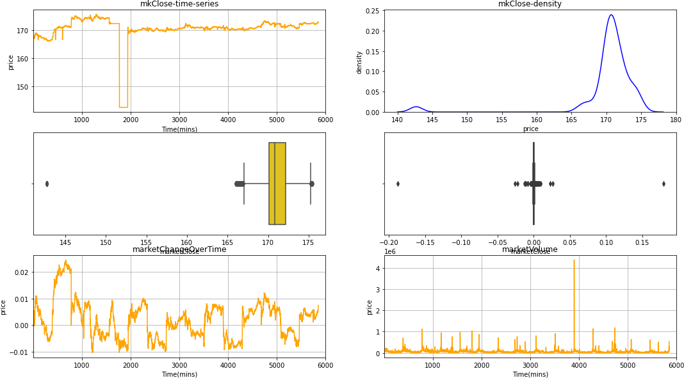
1. Data Visualization : AAPL
Figure 1: This is a plot for market Close, Change over time and volume.

Slide 3
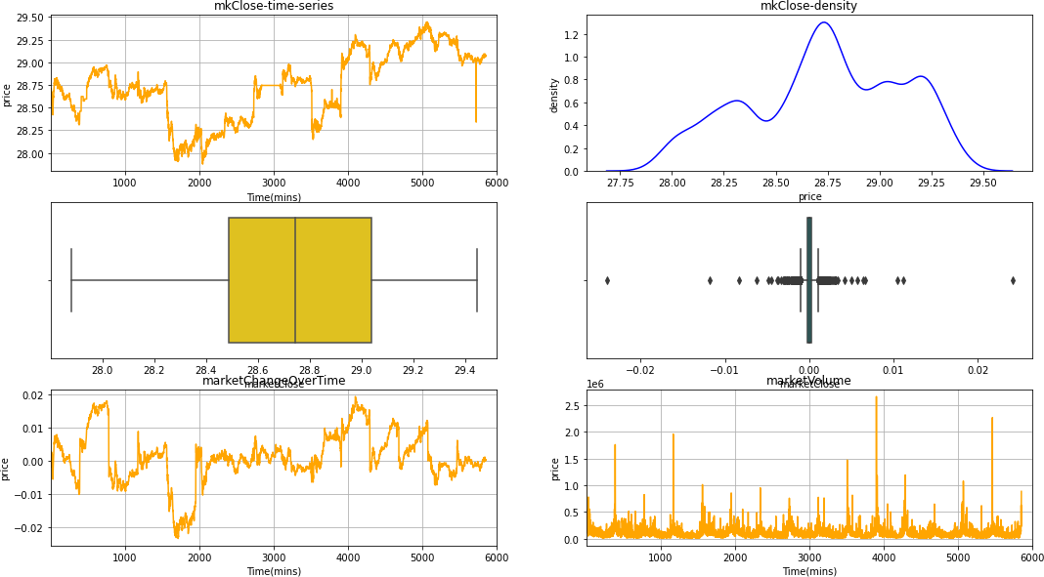
2. Data Visualization : BAC
Figure 2: This is a plot for market Close, Change over time and volume.

Slide 4
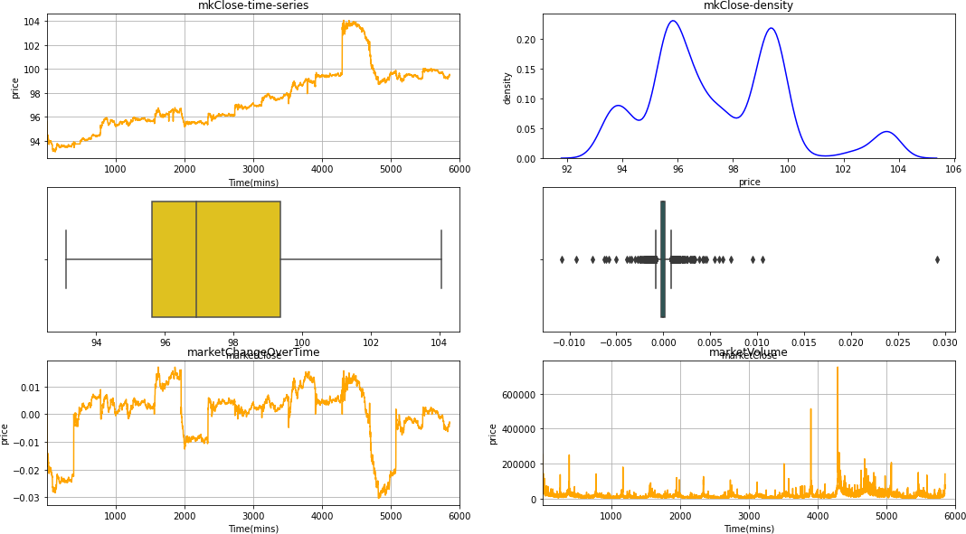
3. Data Visualization : WMT
Figure 3: This is a plot for market Close, Change over time and volume.

Slide 5
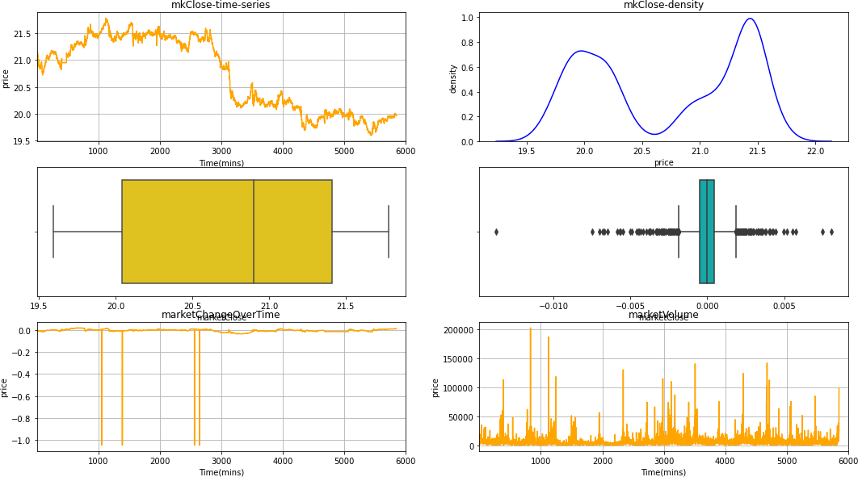
4. Data Visualization : AEO
Figure 4: This is a plot for market Close, Change over time and volume.

Slide 6
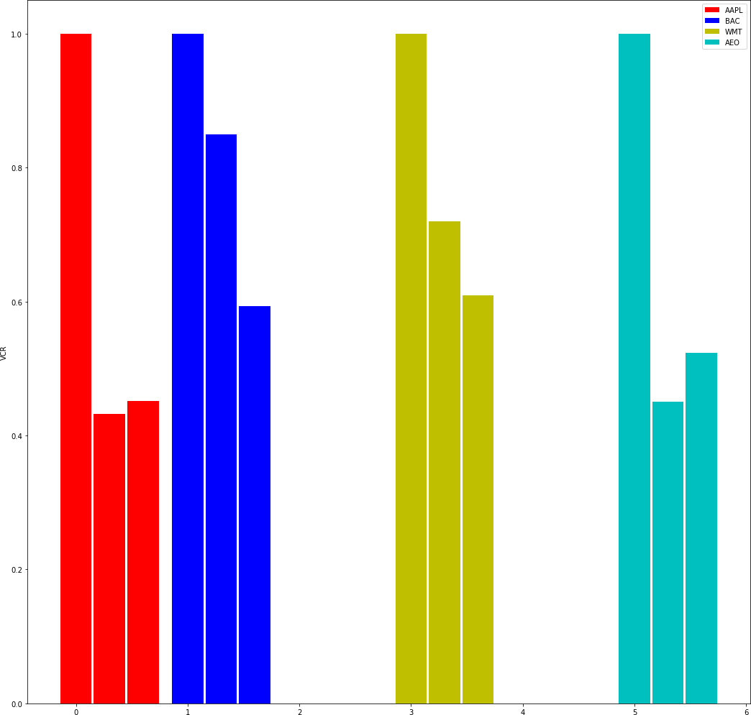
3 Question 2,3
Compute the variance concentration ratios of data and visualize it. What can you find?
Compare the variance concentration ratios of the normalized data of the data by using different normalization methods
Figure 5: The first bar is for VCR, second for MinMax VCR and third for StandardScaler VCR.

Slide 7
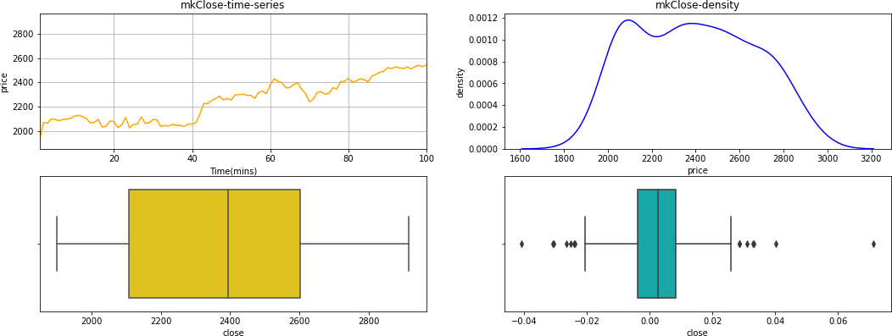
4 Question 4
Apply 1,2,3 to at least your own two datasets in finance
Data Visualization : GOOG
Figure 6: This is a plot for market Close, Change over time and volume.

Slide 8
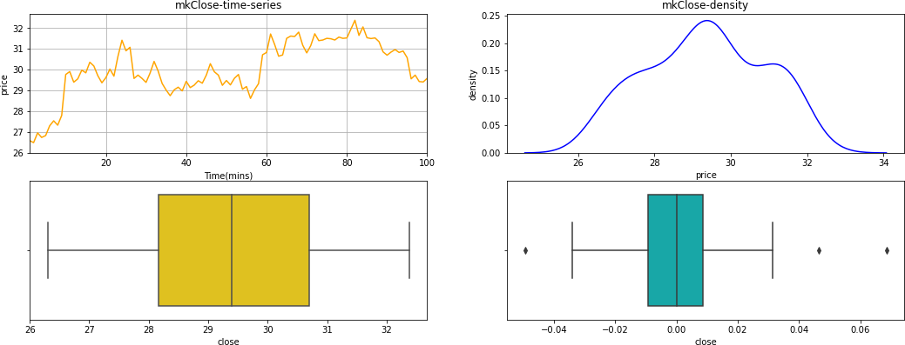
2. Data Visualization : HSBC
Figure 7: This is a plot for market Close, Change over time and volume.

Slide 9
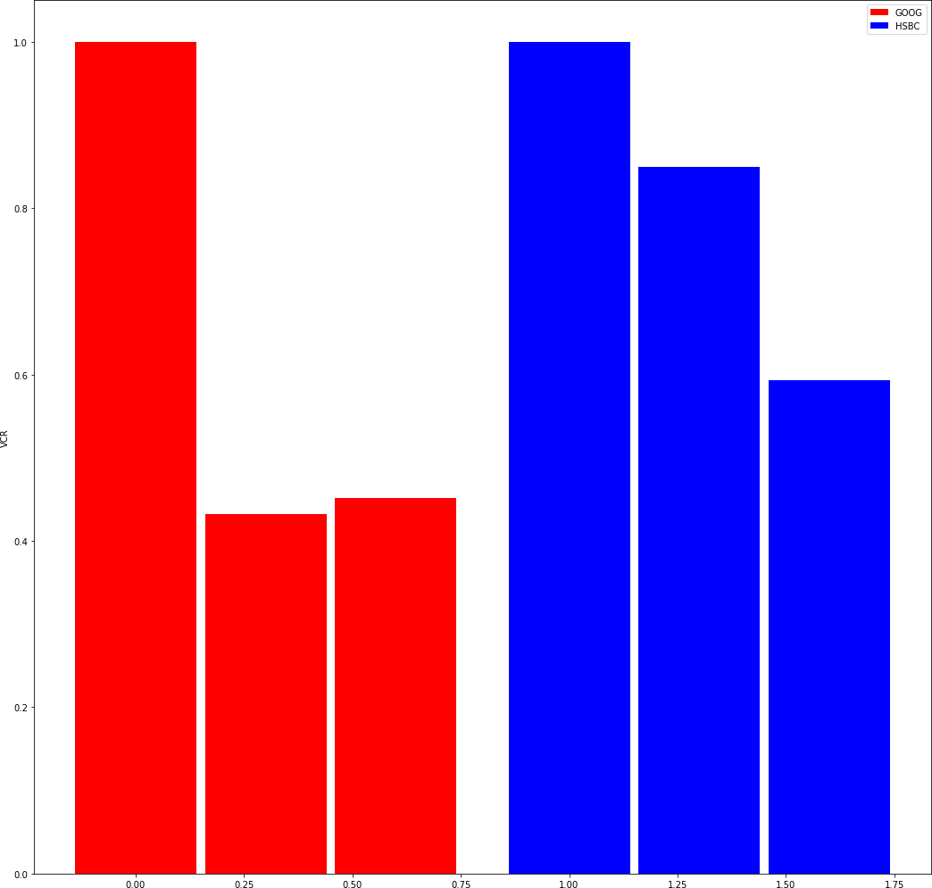
VCR Plot for GOOG and HSBC
Figure 8: The first bar is for VCR, second for MinMax VCR and third for StandardScaler VCR.
5 Question 5
What are your conclusions? why?
Variance concentration ratios are very similar across different stocks for raw data. There is more difference in MinMax and Standard Scalar normalized data. So, normalization is really crucial to analyze variance concentration , which might give insights into volatility in stock price.

Slide 10
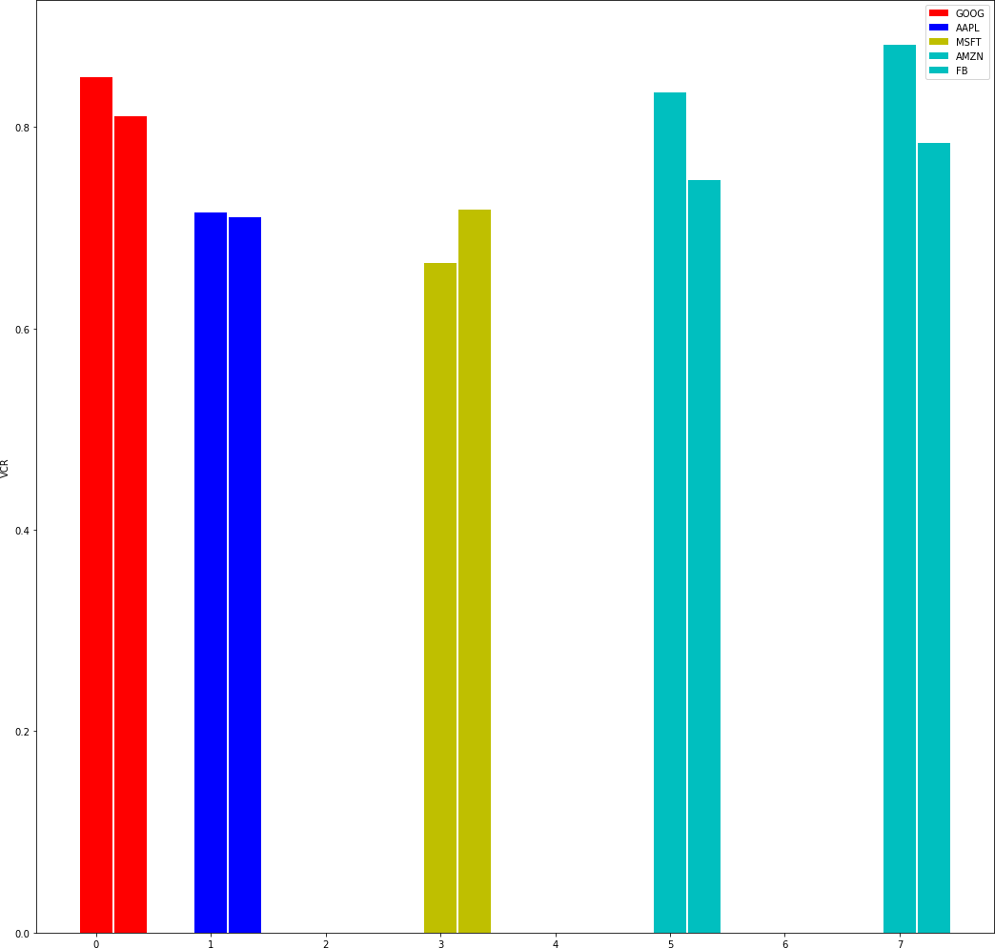
6 Question 1
Write software to retrieve recent 1 week HFT data for the following stocks
def retrieveStockH(ticker_name, start_time, end_time, API): TI=’af3fb5397b00b669904c3e1212800ed9b586c084’
stock_data=web.get_data_tiingo(ticker_name, start_time, end_time, api_key=TI)
return stock_data
goog = retrieveStockH(’AMZN’,’2/1/2021’, ’9/1/2021’, api_key)
Compare their variance concentration ratios under different normalization methods, what can you find?
IT: GOOG, AAPL, MSFT, AMZN, FB
Figure 9: The first bar is for MinMax VCR and second for StandardScaler VCR.

Slide 11
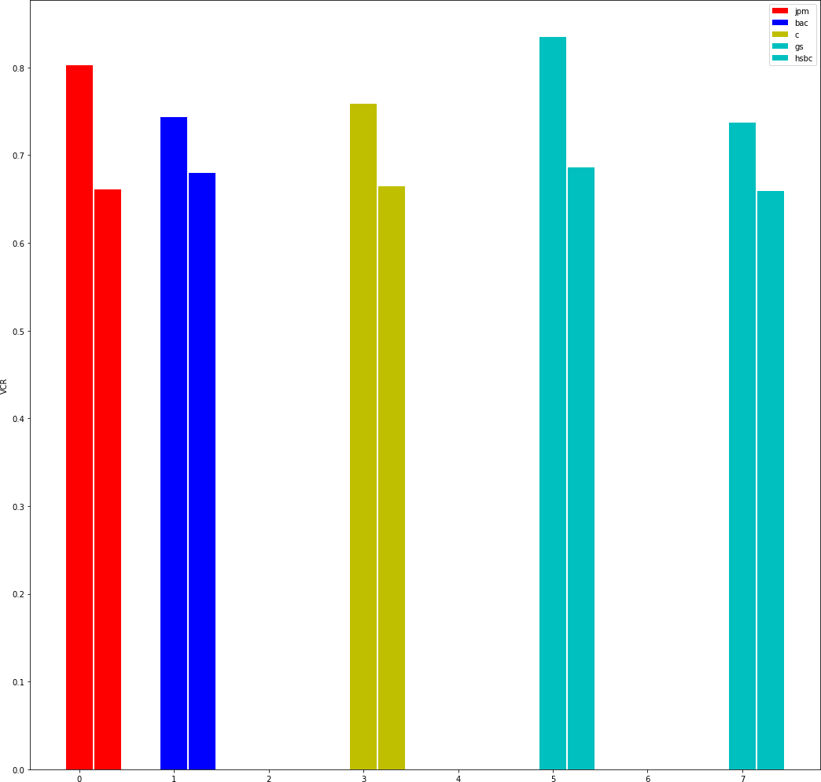
Bank: ’JPM’, ’BAC’, ’C’ , ’GS, ’HSBC’
Figure 10: The first bar is for MinMax VCR and second for StandardScaler VCR.
Compare their variance concentration ratios under different normalization methods, what can you find?
There is more difference in MinMax normalized data. So, minmax normalization is probably better than scaling the data. A comparison with centering can be interesting too.

Slide 12
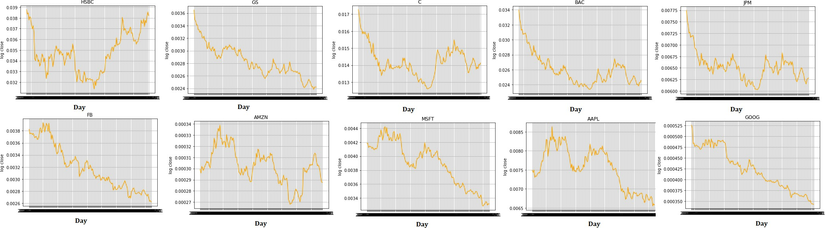
1. Calculate the stock log returns in each time interval for each stock and plot it
Figure 11: Log return for daily closing price.

Slide 13
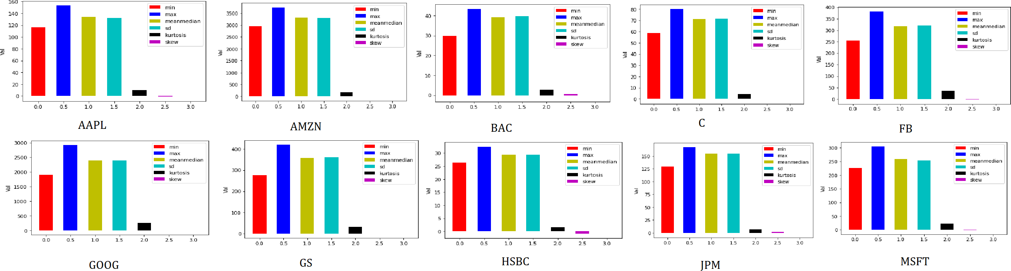
2. Compute the max, min, mean, median, standard deviation, skewness, kurtosis for close price and volume for each data set (need plots).
Close Price : Comparison by Stock.

Slide 14
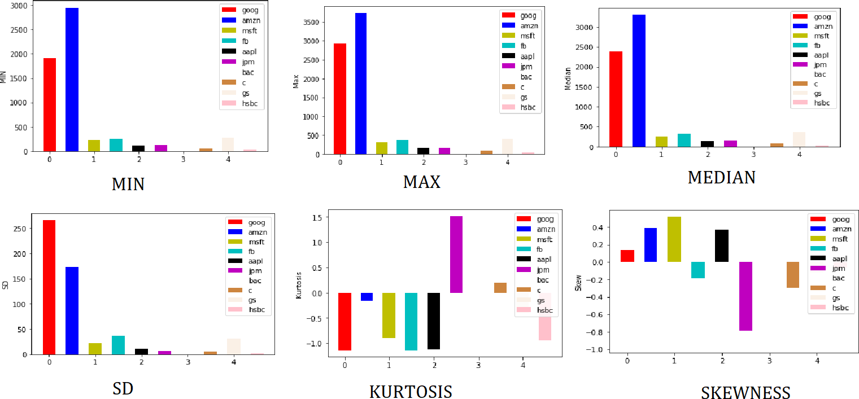
Figure 12: Comparison by Attribute.

Slide 15
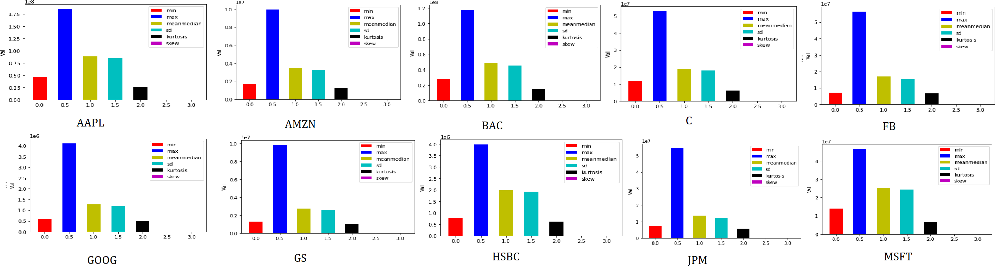
Volume
Figure 13: Comparison by Stock.

Slide 16
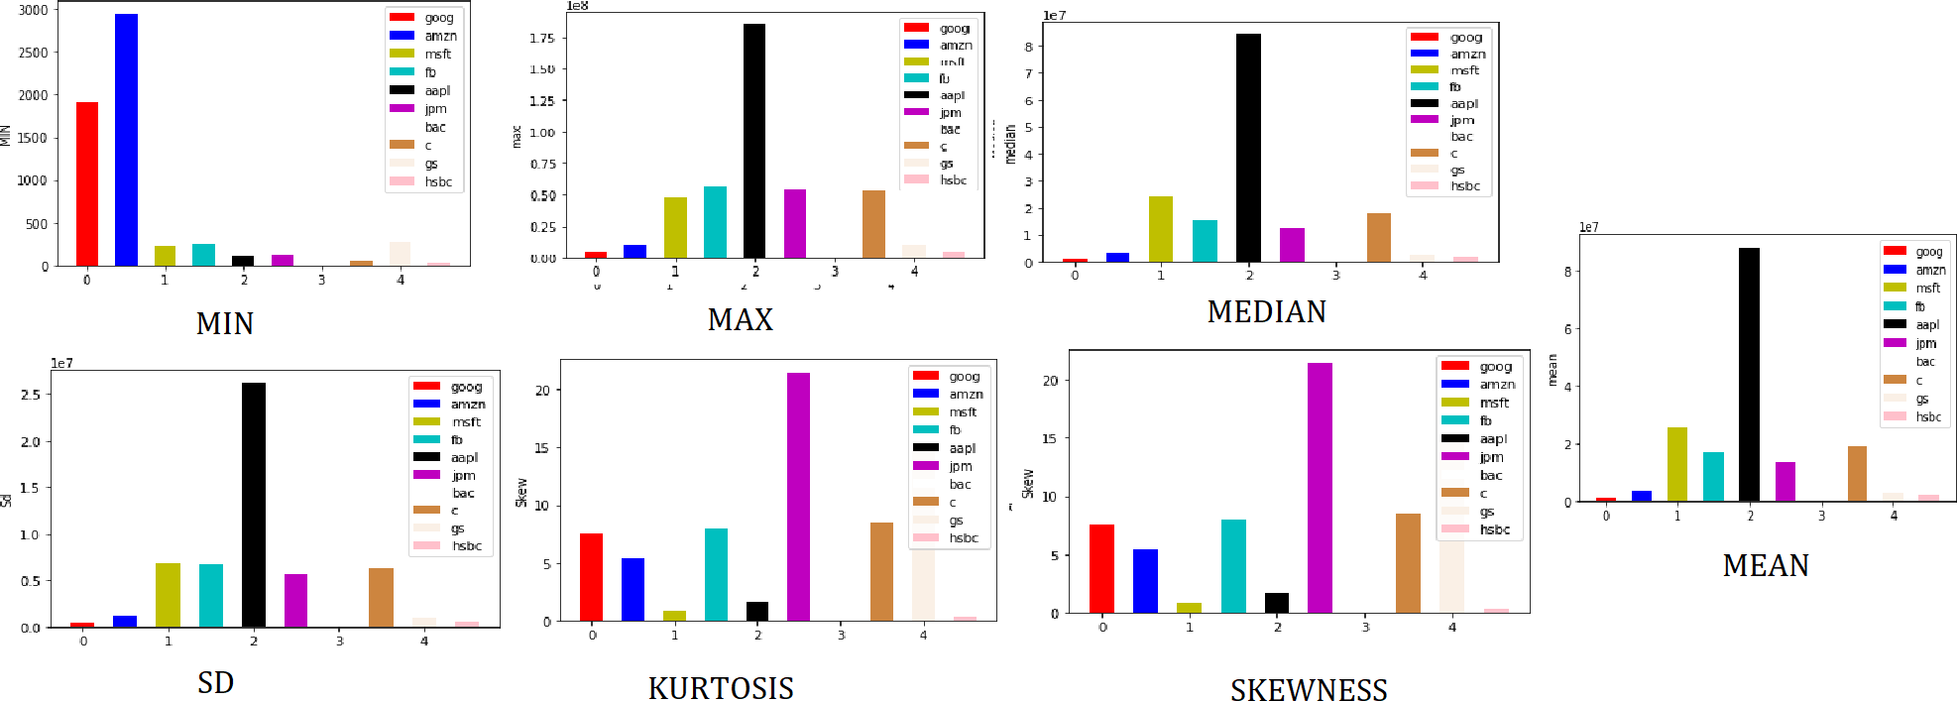
Figure 14: Comparison by Attribute.
1. Retrieve daily stock data for the following types of companies from 02/01/2015 to 02/01/2021and write it in csv – IT: GOOG, AAPL, MSFT, AMZN, FB – Bank: ’JPM’, ’BAC’, ’C’ , ’GS, ’HSBC’

Slide 17
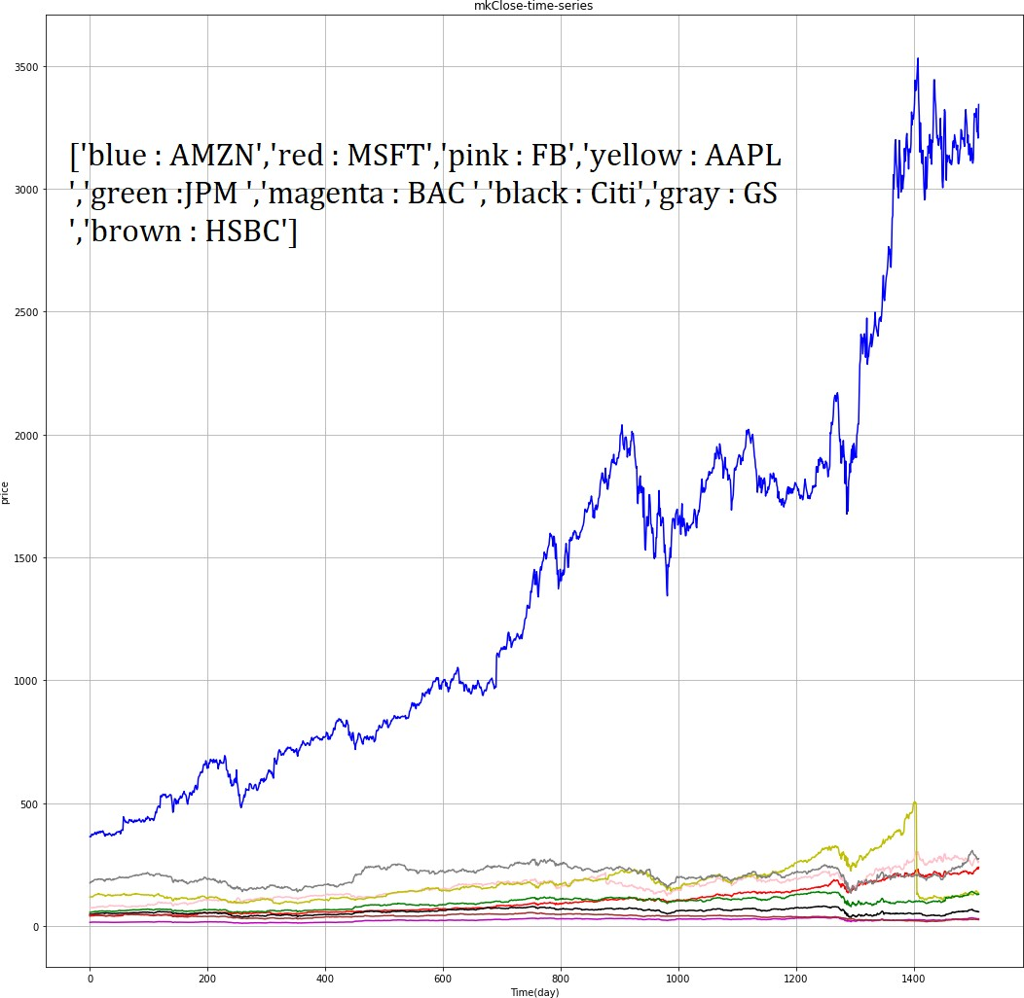
1. Compare the stock price patterns of these companies during the years
Figure 15: [’blue : AMZN’,’red : MSFT’,’pink : FB’,’yellow : AAPL ’,’green :JPM ’,’magenta
: BAC ’,’black : Citi’,’gray : GS ’,’brown : HSBC’]

Slide 18
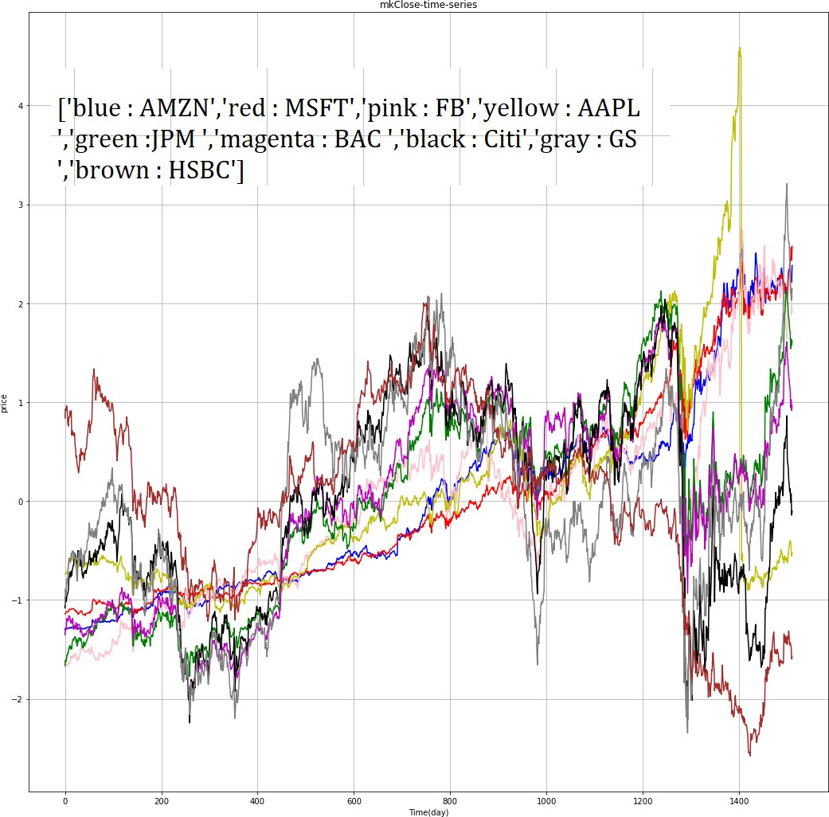
Figure 16: [Standard Sclaler Norm Plot

Slide 19
2. Calculate the days of up and down for each stock in each year.
Number of Days up and Down based on open and close price
GOOG : 88
AMZN : 753
MSFT : 696
FB : 730
AAPL : 696
JPM : 723
BAC : 736
C : 723
GS : 754
HSBC : 742
References
[1]Khoshrou2017SVDbasedVA, title=SVD-based visualisation and approximation for time series data in smart energy systems, author=Abdolrahman Khoshrou and Andre B. Dorsman and Eric J. Pauwels, journal=2017 IEEE PES Innovative Smart Grid Technologies Conference Europe (ISGT-Europe), year=2017, pages=1-6

